Slide 1
FROM PIPELINE TO REVENUE
Predicting a company’s proposal wins and losses from its sales pipeline
Andres Forero

Slide 2
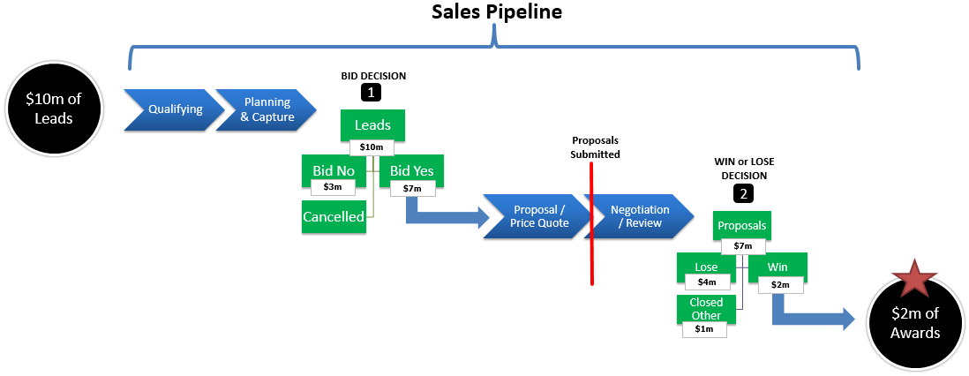
What is a sales pipeline?
Under the Insert tab, click “Header & Footer”
In the dialog box that opens, check the box labeled “Slide number”
Click “Apply to All” to apply to every slide in your presentation.

Slide 3
Project Goal
Use algorithm to classify each opportunity in the sales pipeline as either:
Wins
Losses
Bid No / Cancel / Closed Other

Slide 4
How can Company B benefit from this model?
Predict “Wasted Bids”:
Allows proposal department to not waste time and resources (B&P budget)
Potentially remove “Wasted Bids” from pipeline (preferably before Decision 1)
Concentrate on either acquiring new leads or on converting existing opportunities to wins.
Predict Awards (proposals won) in $ dollars:
Allows CFO to forecast Awards for future fiscal year-ends
Forecast revenue
Is sales pipeline large enough to sustain revenue and earnings growth targets?
Prioritize strategic spending decisions
1. Predict “Wasted Bids”:
2. Predict Awards (proposals won) in $ dollars:

Slide 5
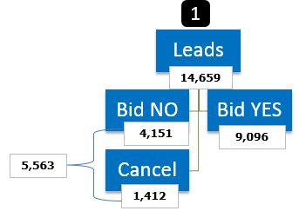
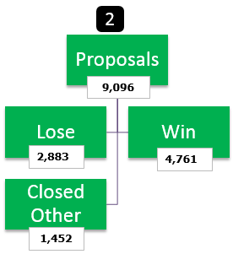
Training / Testing Data

Slide 6
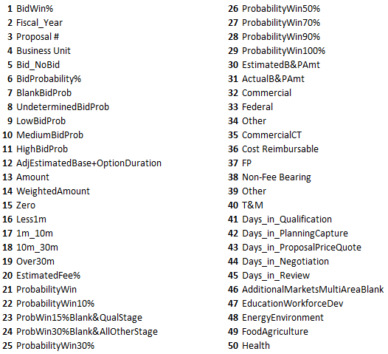
Features Utilized

Slide 7
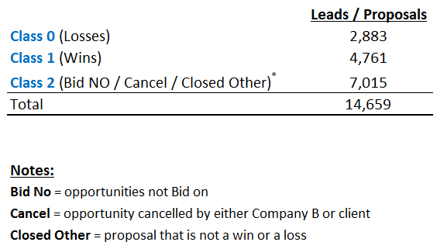
Target Labels

Slide 8
Algorithms Tested
Logistic Regression
Decision Trees
Random Forests
Support Vector Machines
K Nearest Neighbors
XGBoost

Slide 9
Model Evaluation
The model with both the highest Precision and Recall scores for the appropriate Decision point was chosen the winner:
Decision 1 (Bid vs. No Bid) → Recall more important
Decision 2 (Win vs. Lose) → Precision more important

Slide 10
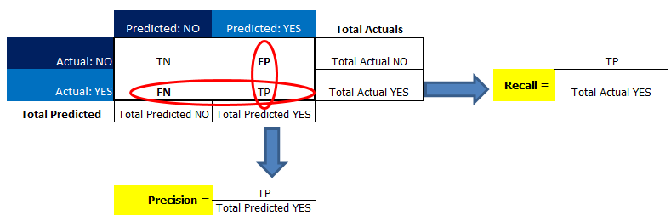
Decision 1: Recall More Important
False Negatives More Costly
Over-predicting “Bid No” (under-predicting “Bid Yes”)
False Positives Less Costly:
Over-predicting “Bid Yes” (under-predicting “Bid No”)
1. False Negatives More Costly
2. False Positives Less Costly
GOAL → Reduce False Negatives

Slide 11
Decision 2: Precision More Important
False Negatives More Costly
Over-predicting “Wins” (under-predicting “Losses”)
False Positives Less Costly:
Over-predicting “Losses” (under-predicting “Wins”)
1. False Positives More Costly
2. False Negatives Less Costly

Slide 12
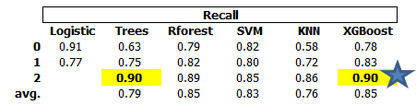
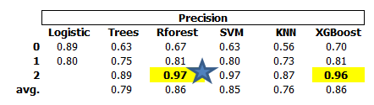
Model Results – Decision 1
XGBoost and Trees had the best Recall scores.
Random Forests and XGBoost had the best Precision scores
Given Recall is more important for Decision 1, XGBoost is the most consistent choice.

Slide 13
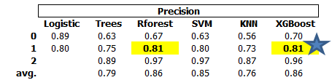
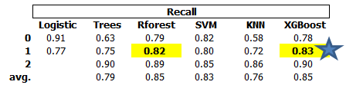
Model Results – Decision 2
XGBoost and Random Forests had the best Precision scores:
XGBoost and Random Forests had the best Recall scores:
Given Precision is more important for Decision 2, XGBoost or Random Forests would both be good choices, but to be consistent with Decision 1, I chose XGBoost the winner.

Slide 14
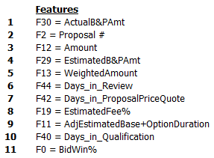
XGBoost – Features Importance

Slide 15
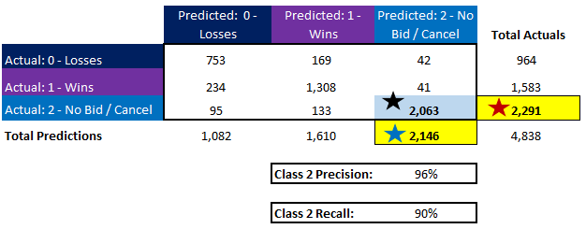
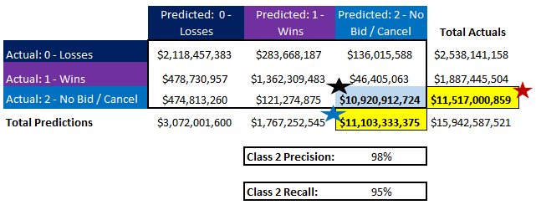
Decision 1 - Confusion Matrices
1. Class 2 - Number of Leads:
2. Class 2 - In $ dollars:

Slide 16
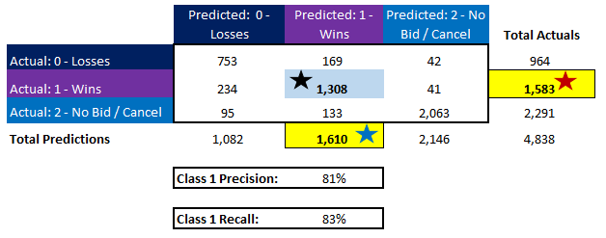
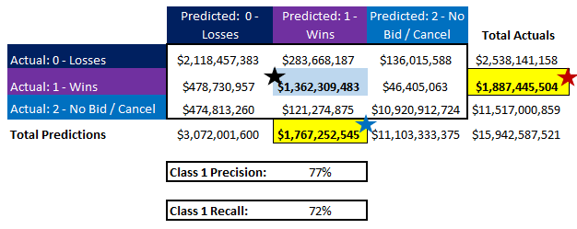
Decision 2 - Confusion Matrices
1. Class 1 - Number of Proposals:
2. Class 1 - In $ dollars:

Slide 17


XGBoost Model vs. Weighted Pipeline Amount
XGBoost predicted a number lower than Actual wins (this is better), and it also had a much smaller variance:
1. XGBoost Prediction
2. Weighted Pipeline Amount Prediction

Slide 18
Recommendations
1. Indefinite testing phase
Indefinite Testing Phase
Test XGBoost in parallel with Weighted Pipeline Amount (WPA) method
If XGBoost does better, discontinue WPA method
If results are varied, but XGBoost adds value, then continue both methods.
Institute Procedures to Control Outliers
Before finalizing any forecasts, one can verify very large deal $ amounts with Proposal Leaders before committing to the numbers.
Improve Salesforce Data
Data can be greatly enriched and cleansed
It would be good to have more information about competitors on proposals
It would be good to have information on proposal leader success rates
2. Institute Procedures to Control Outliers
3. Improve Salesforce Data

Slide 19
More Information
Andres Forero
Aspiring Data Scientist
999-999-9999

